Slide 1

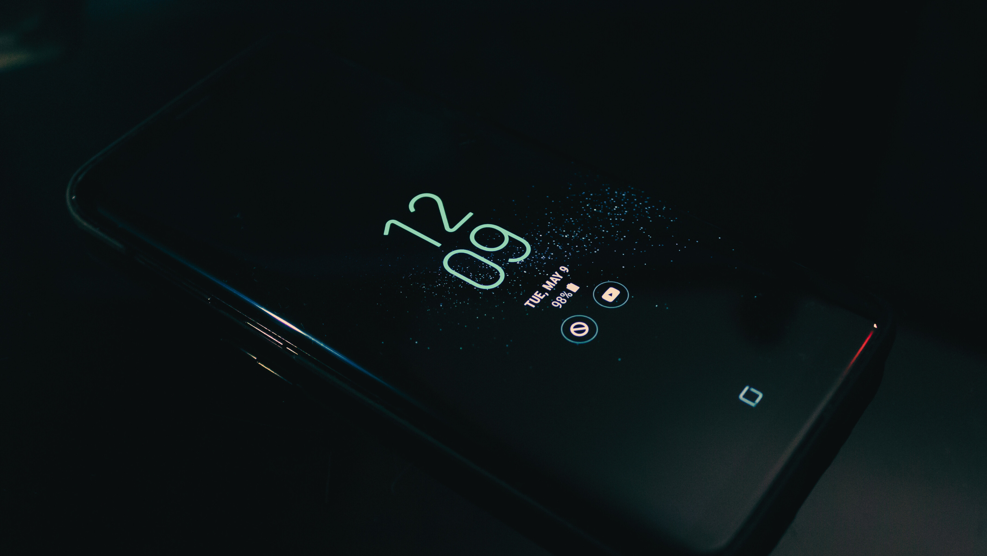

UNIT 1
INTRODUCTION TO MOBILE OPERATING SYSTEM
BY: ASHWIN CHAVAN

Slide 2
TABLE OF
01
INTRODUCTION
CONTENTS
02
SYSTEM PERFORMANCE AND MODELS
03
ISSUES AND LIMITATIONS

Slide 3
01
INTRODUCTION

Slide 4

INTRODUCTION
A mobile operating system (OS) is the software that powers smartphones, tablets, and other handheld devices.
It serves as the foundation upon which applications run and enables users to interact with their devices. Just as a computer needs an operating system to function, mobile devices rely on mobile operating systems to provide essential functionalities and user experiences.
Key Points:
Device Management: Mobile OS manages hardware components like the processor, memory, storage, and input/output systems. It ensures that resources are allocated efficiently and optimally to various applications.
Multitasking: Mobile OS allows users to run multiple applications simultaneously, seamlessly switching between them and managing their performance.
Connectivity: Mobile OS integrates various connectivity features like Wi-Fi, cellular data, Bluetooth, and NFC, enabling communication and data exchange.

Slide 5
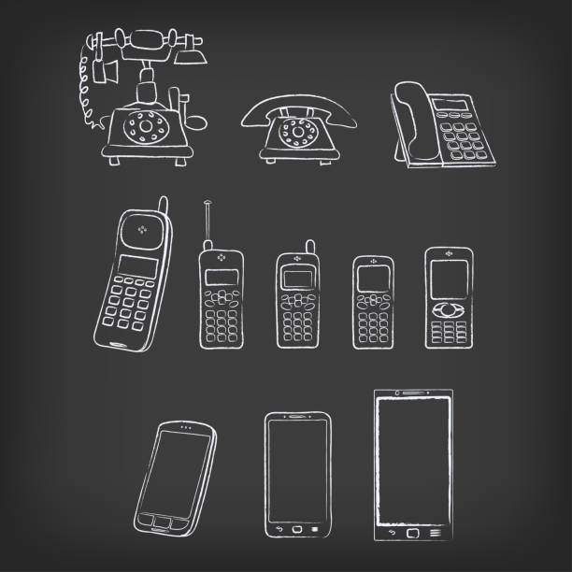
HISTORY OF
MOBILE OPERATING SYSTEM
Elaborate on what you want to discuss.

Slide 6
Some of the MOS Interface that were Created
Some of the mobile operating systems interface that were created
Palm OS(1996-2009):- Developed by Palm, Inc., Palm OS was one of the earliest mobile operating systems. It gained popularity in the late 1990s and early 2000s, especially with personal digital assistants (PDAs) like the Palm Pilot. It featured a stylus-driven interface and supported basic applications.
Windows Mobile(2000-2010):-Developed by Microsoft, Windows Mobile was used in various smartphones and PDAs. It offered a wide range of applications, but its interface was considered less user-friendly compared to later systems.
Symbian OS (1998-2013): Developed by a consortium of companies, including Nokia, Symbian was one of the most widely used mobile OS in the early 2000s. It powered many Nokia smartphones and featured customizable user interfaces.

Slide 7
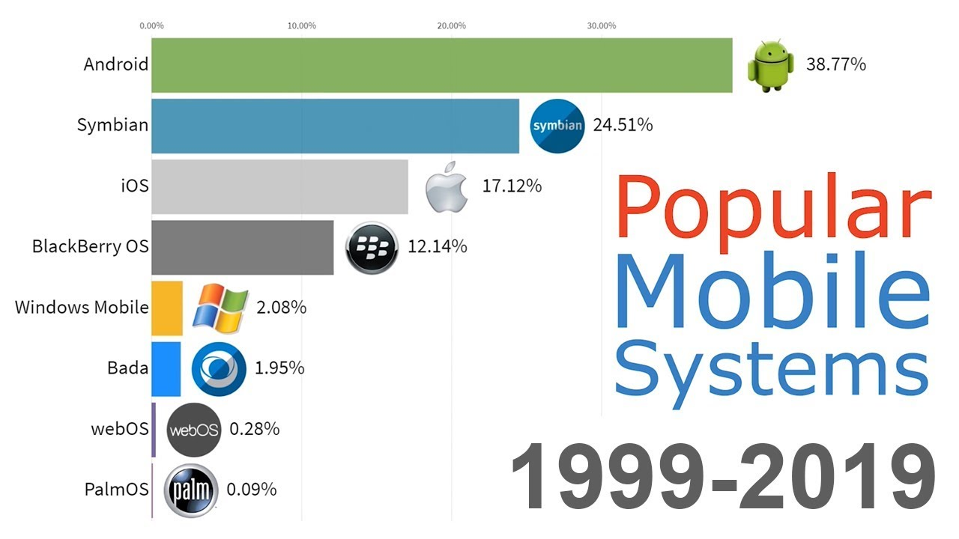


Slide 8
iOS (2007-present):- Developed by Apple, iOS revolutionized the smartphone industry with the launch of the iPhone in 2007. It introduced the concept of the App Store and offered a highly intuitive and user-friendly interface.
Android OS (2008-present): Developed by Google, Android is the most widely used mobile operating system today. It's an open-source platform that allows various manufacturers to create their own devices running on Android. Android has evolved through various versions, offering improved performance, features, and app compatibility.
Windows Phone (2010-2017): A successor to Windows Mobile, Windows Phone introduced a new, tile-based interface. While it received praise for its unique design, it struggled to gain significant market share and was eventually phased out.

Slide 9
OS Interface
The operating system (OS) interface is the bridge that allows users and applications to interact with the underlying computer hardware and services. It provides a means for users to issue commands, manage files, run applications, and access system resources. There are two primary types of OS interfaces: the Command-Line Interface (CLI) and the Graphical User Interface (GUI).
1. Command-Line Interface (CLI):
A text-based interface where users enter commands using a keyboard.
Efficient for experienced users and automation tasks.
Provides direct access to system functions and utilities.
Examples include the Unix/Linux shell (Bash), Windows Command Prompt, and PowerShell.
2. Graphical User Interface (GUI):
A visual interface that uses icons, menus, and windows to interact with the OS.
Designed for ease of use and accessibility for a wider range of users.
Offers a more intuitive way to perform tasks through pointing and clicking.
Examples include Windows Explorer, macOS Finder, and desktop environments in Linux distributions.

Slide 10
MultiLevel View of OS
What are multilevel Views?
Multilevel views refer to different perspectives or abstractions of an operating system (OS) that cater to various user groups and their specific needs.
These views provide different levels of detail and interaction, allowing different users to interact with the OS in a manner that aligns with their roles, responsibilities, and expertise.
Multilevel views are designed to enhance usability, efficiency, and customization by tailoring the OS experience to different types of users.

Slide 11
The concept of multilevel views helps optimize user experiences by allowing each user group to interact with the operating system in ways that align with their expertise and tasks. This approach promotes efficiency, reduces complexity, and enhances the overall usability of the OS.
In essence, a multilevel view of an operating system offers distinct interfaces, functionalities, and tools that cater to different categories of users, such as end-users, system administrators, and developers.
Each view provides the necessary features and controls for the specific tasks and interactions associated with that user group.
Examples of operating systems that implement multilevel views include Windows, macOS, and Linux, where each of these platforms provides distinct interfaces and tools for end-users, administrators, and developers.

Slide 12
Categories in OS
Network Operating Systems (NOS):
Manage and coordinate network resources, allowing multiple computers to communicate and share resources.
Examples: Novell NetWare, Windows Server, Linux-based NOS.
Distributed Operating Systems:
Run on multiple machines, interconnected and working together as a single system.
Examples: Amoeba, Plan 9 from Bell Labs.
Mobile Operating Systems:
Designed for mobile devices like smartphones and tablets.
Emphasize touch interfaces, battery optimization, and mobility.
Examples: iOS, Android, KaiOS.
Single-User Operating Systems:
Designed for use by a single user on a personal computer or workstation.
Examples: Windows, macOS, Linux (desktop distributions).
Multi-User Operating Systems:
Support multiple users simultaneously, often on networked systems.
Examples: Unix, Linux (server distributions), Windows Server.
Real-Time Operating Systems (RTOS):
- Prioritize tasks and manage resources to meet strict timing constraints.
- Used in applications like robotics, aerospace, and industrial control systems.
- Examples: QNX, VxWorks, FreeRTOS.

Slide 13
Small and Specialized OS
An embedded operating system is a specialized operating system designed to perform a specific task for a device that is not a computer. The main job of an embedded OS is to run the code that allows the device to do its job.
The embedded OS also makes the device's hardware accessible to software that is running on top of the OS.
An embedded OS often works within an embedded system. An embedded system is a computer that supports a machine. It performs one task in the bigger machine.
Examples include computer systems in cars, traffic lights, digital televisions, ATMs, airplane controls, point of sale (POS) terminals, digital cameras, GPS navigation systems, elevators and Smart meters.

Slide 14
How Does Embedded OS Work ?
An embedded OS enables an embedded device to do its job within a larger system. It communicates with the hardware of the embedded system to perform a specific function.
For example, an elevator might contain an embedded system, such as a microprocessor or microcontroller, that lets it understand which buttons the passenger is pressing. The embedded software that runs on that system is the embedded OS.
In contrast to an OS for a general-purpose computer, an embedded OS has limited functionality. Depending on the device in question, the system may only run a single embedded application.
However, that application is likely crucial to the device's operation. Given that, an embedded OS must be reliable and able to run with constraints on memory and processing power.

Slide 15
64 Bits OS
64-bit OS are an operating system that can process 64 bits at once in a machine. In recent times the majority of personal computers are using a 64-bit architecture, and 64-bit CPUs are also introduced to mobile devices in the years 2014–2015. A 64-bit OS will not be supported by a 32-bit system, but a 32-bit OS will be supported by a 64-bit system.
A generation of computers known as 64-bit is those that typically use 64-bit CPUs. More specifically, 64-bit refers to the size of the microprocessor or computer bus registers in the 64-bit system.
In general, 2⁶⁴ memory addresses, or 18 quintillion bytes of RAM, are accessible to 64-bit systems. It means that 64-bit systems can easily manage any memory size larger than 4 GB of RAM. Software that has been compiled to operate on 64-bit hardware is commonly referred to as x86-64.

Slide 16
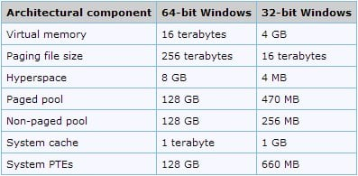
64-bit OS are operating systems that can process 64 bits at once in a machine, and 64-bit systems can easily manage any memory size larger than 4 GB of RAM.
64-bit operating systems are important in today's world to speed up the solving processes of complex and heavy computing problems.
Mac OS X Snow Leopard was the first complete 64-bit operating system, and the iPhone 5s was the first smartphone to use a 64-bit processor (Apple A7).

Slide 17
Processes and Threads
Processes: Independent execution units that have their own memory space, resources, and program code, providing isolation and parallelism.
Threads: Smaller units within processes that share the same memory space, enabling efficient multitasking and better resource utilization.
Communication: Threads within a process can communicate and share data more easily than processes, as they share memory.
Scheduling: Processes and threads are scheduled by the OS's scheduler to execute on the CPU, balancing fairness and efficiency.
Concurrency: Threads enable concurrent execution, allowing multiple tasks to progress simultaneously, improving system responsiveness.

Slide 18
02
SYSTEM PERFORMANCE AND MODELS

Slide 19

PERFORMANCE OF
COMPUTER SYSTEMS
The performance of computer systems refers to their ability to efficiently execute tasks and process data.
It is measured by factors like processing speed, response time, throughput, and resource utilization.
A high-performance computer system exhibits quick execution, minimal latency, and optimal resource allocation, leading to enhanced productivity and user satisfaction.
Performance analysis involves benchmarking, profiling, and optimization techniques to identify and address bottlenecks, ensuring optimal system operation.
Continuous monitoring and improvement of performance are crucial to meet evolving computational demands and user expectations.

Slide 20
PERFORMANCE
Performance metrics are measures used to assess the efficiency, effectiveness, and overall quality of a system or process. These metrics help quantify performance and guide improvements:
METRICS
Throughput Measures the rate at which a system processes tasks or transactions, indicating its processing capacity. | Latency Represents the time delay between initiating an action and receiving a response, highlighting system responsiveness. | Resource Utilization Tracks the efficiency of resource consumption, such as CPU, memory, and bandwidth, indicating optimal resource allocation.
Error Rate Evaluates the frequency of errors or failures, reflecting system reliability and stability. | Response Time Measures the time taken for a system to complete a specific operation, influencing user experience and task efficiency.

Slide 21
WORKLOAD AND SYSTEM PARAMETERS
Workload refers to the tasks and activities that a computer system performs, including processing, data storage, and communication.
System parameters encompass characteristics like memory, CPU utilization, network traffic, and latency.
Balancing workload and system parameters ensures efficient resource allocation and optimal performance, preventing bottlenecks and ensuring a responsive and reliable computing environment.

Slide 22
SIMULATION MODELS
AND ITS TYPE
DISCRETE-EVENT MODEL
STOCHASTIC MODEL
MONTE CARLO SIMULATION
SYSTEM DYNAMICS

Slide 23
Simulation Models And Its Types
Simulation models are mathematical representations of real-world systems or processes, allowing experimentation in a controlled virtual environment.
These models enable analysis, prediction, and optimization of complex scenarios, aiding decision-making.
They provide insights into system behavior, interactions, and outcomes, facilitating understanding and improvement.
Simulation models find applications in diverse fields like engineering, healthcare, economics, and logistics, enhancing problem-solving and innovation.
Its Types are: Discrete-Event Model, Stochastic Model, Monte Carlo Simulation, Agent-Based Simulation and System Dynamics.

Slide 24
DISCRETE-EVENT MODEL
The discrete-event model is a simulation approach where system changes occur at specific points in time, known as events.
Events represent state transitions or occurrences that affect the system's behavior.
Between events, the system remains unchanged, making it suitable for modeling dynamic, asynchronous processes.
It's widely used in areas like computer networks, manufacturing, and queuing systems to analyze complex interactions.
By tracking event occurrences and their effects, the model provides insights into system performance, bottlenecks, and optimizations.
Discrete-event simulation enables efficient testing of scenarios and helps make informed decisions in complex real-world systems.
Overall, this model simplifies complex systems into manageable event-based interactions, aiding analysis and problem-solving.
Notes:
To be continue

Slide 25
STOCHASTIC MODEL
A stochastic model is a mathematical framework used to represent and analyze random events and their outcomes.
It involves probabilities and randomness to predict and understand various real-world phenomena, such as financial markets, weather patterns, and queueing systems.
Stochastic models offer insights into uncertainty, allowing researchers to make informed decisions and predictions based on probabilistic calculations.
These models often involve simulations or mathematical equations to simulate and study the behavior of systems subject to randomness, aiding in risk assessment and decision-making.

Slide 26
KERNAL STRUCTURE
Core Component: Central part of the operating system.
Memory Management: Allocates and manages system memory.
Process Management: Controls and schedules tasks or processes.
Device Drivers: Interfaces with hardware components.
File System: Manages storage and data organization.
Network Stack: Facilitates communication over networks.
System Calls: Interfaces for user programs to access kernel services.
Security and Permissions: Enforces access control and system protection.

Slide 27
03
ISSUES AND LIMITATIONS

Slide 28
DESIGN ISSUES AND MOBILE OS
Power Efficiency:: Balancing performance with battery life to optimize mobile device usage.
Resource Constraints: Managing limited memory, processing power, and storage in compact devices.
Security: Ensuring data protection, secure communications, and app sandboxing.
Multitasking: Efficiently handling concurrent app execution while maintaining user responsiveness.
User Interface: Designing intuitive touch-based interfaces for varied screen sizes.
Connectivity: Managing seamless transitions between different networks (Wi-Fi, cellular) and protocols.
App Compatibility: Ensuring apps work across various hardware configurations and OS versions.
Updates:: Facilitating timely and seamless updates for security patches and new features.

Slide 29
LIMITATIONS OF MOBILE DEVICES
Limited Processing Power: Mobile devices have constrained processing capabilities compared to desktop computers.
Limited Storage: Storage space on mobile devices is often limited, affecting the amount of data and apps that can be stored.
Battery Life: Mobile devices have relatively short battery life, requiring frequent recharging.
Screen Size: Small screens can hinder complex tasks and limit content visibility.
Multitasking Constraints: Multitasking capabilities are restricted, impacting simultaneous app usage.
Network Dependence::Mobile devices heavily rely on network connectivity, affecting functionality in areas with poor reception.
Security Vulnerabilities:: Mobile devices can be susceptible to malware and security breaches.
Hardware Fragility: Mobile devices are prone to physical damage due to their portability and fragile components.

Slide 30
CONCLUSION
01
Introduction
03
Issues
History. 64 bits, Embedded OS
02
System Performance and Models
04
Limits

Slide 31
THANK YOU!

